Slide 1

Ever felt like destroying something beautiful? Now you can…
An Augmented Reality Game By Ziv Levy (036574226) & Tomer Cagan (035944107)

Slide 2



Play in Your Own World
Augmented Reality game in which the player interacts with its environment – destroying it as the game progress.
Traditional “wall-breaker” on steroids:
The walls are real walls as well as the objects in the scene, such as a clock, pictures, buildings and more…
The scene is the world – any place can transform into an exciting game scene
Adopted to up-to-date devices using touch…
Bring in social aspects which wasn’t existed in the original creation time

Slide 3

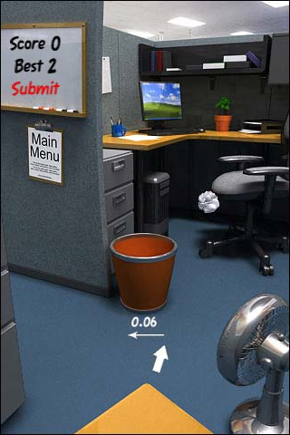

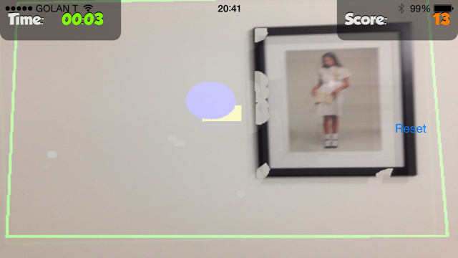
Why Another “Wall Breaker”?
Traditional games isolates the player – we want the player to interact in the world
Viewing the real world via camera, the player has to react to its environment
No more crouching on top of the device – now you have to face reality

Slide 4
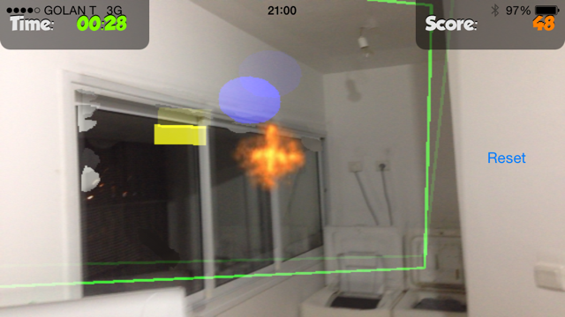
Yes… Real Scenes!
The player is directly involved – designing her own levels
Is meaningful and cool to share (e.g. I just destroyed Eiffel Tower)
More than one person can play in the same scene

Slide 5
Game Flow
Point the camera to the scene
Automatic object detection lets the user decide what she wants to destroy
Clicking to start releases a ball into the scene
As the ball move and hitting objects – the scene is destroyed
Player can direct the ball using barriers where tapping or panning the screen.
When the objects are destroyed, the player wins!

Slide 6
Some Technical Stuff
We were using the OpenCV library, which is an open-source library for image-processing algorithms.
Also we add Box2D – it is an open-source library that implements a world physics.
All code is written in C++, so we can run on iOS devices, Androids, Win32 desktops and etc.

Slide 7
Gamification, Tension and Dilemmas
Time is expensive resource – so hurry up!
The player has limited time to destroy all objects
Otherwise, the player looses
The ball may not be restricted to the device’s screen boundaries.
The ball can run out of the scene so the player has to be careful and use barriers.
Using barriers costs points
sometimes a must (at the edges)
Other times – a dilemma– save time or gain points?
Incentive is to have fun, wreak havoc, and gain as many points as possible and finish before time is up!

Slide 8
DEMO

Slide 9
High Potential for Social Aspects
Share your game-play in social media
Either as a movie or a photo
Multiplayer
Collaborate with another person on scene (random pickup – make new friends ;-)
Vs. mode – you have to save your objects and destroy your opponents’ (random pickup – make new enemies)

Slide 10
Future Work
Increase tension with ball speed
More incentive by randomly catching bonuses
More Time
Ball size (larger/smaller)
Speed up/down
“Fire Ball” (goes through objects
Multiple Balls…

Slide 11
Thank you!
Follow – up: soon on your device…
☺

